Slide 1

IBM Applied Data Science Capstone

Slide 2
Introduction
Bakeries are a popular type of food service establishment, allowing people to express creativity while also serving a unique market. Starting bakery business presents many unique challenges. Just like the other business, bakery is a serious investment. This project presents deeper knowledge prior to opening bakery, and investigate similarities and differences between suburbs in Sydney

Slide 3
Business Problem
This project answers the following question: Where is the best location to open a bakery in Sydney?

Slide 4
Data
1. Suburbs in Sydney, Australia: https://www.kaggle.com/ssk27997/suburbs-in-sydney-australia , containing the list of suburbs in Sydney along with their latitude and longitude.
2. Foursquare Places API, used to search all venues in a suburb.

Slide 5
Methodology
1. Explore the data
2. Use Foursquare Places API to obtain venue information from each suburb
3. Use K Means Clustering to cluster suburbs based on the similarity of venues
4. Summarise clusters, and determine the best cluster to open a bakery

Slide 6
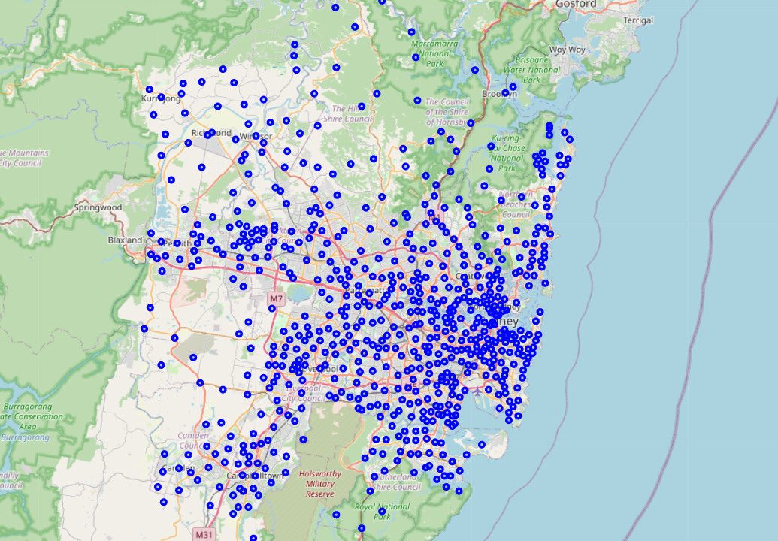
Sydney Suburb
Using The Suburbs in Sydney dataset, we can map the location of the suburbs in Sydney on the map.

Slide 7
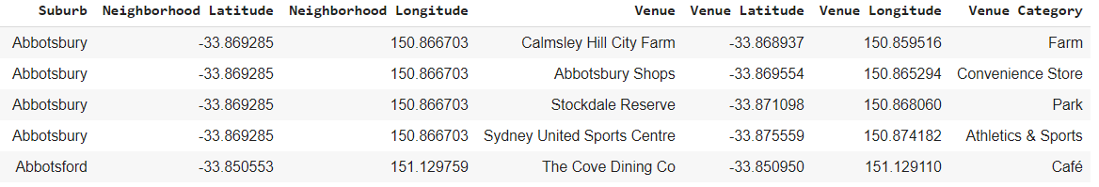
Venues
Using Foursquare Places API, we can obtain information on venues in the suburb

Slide 8
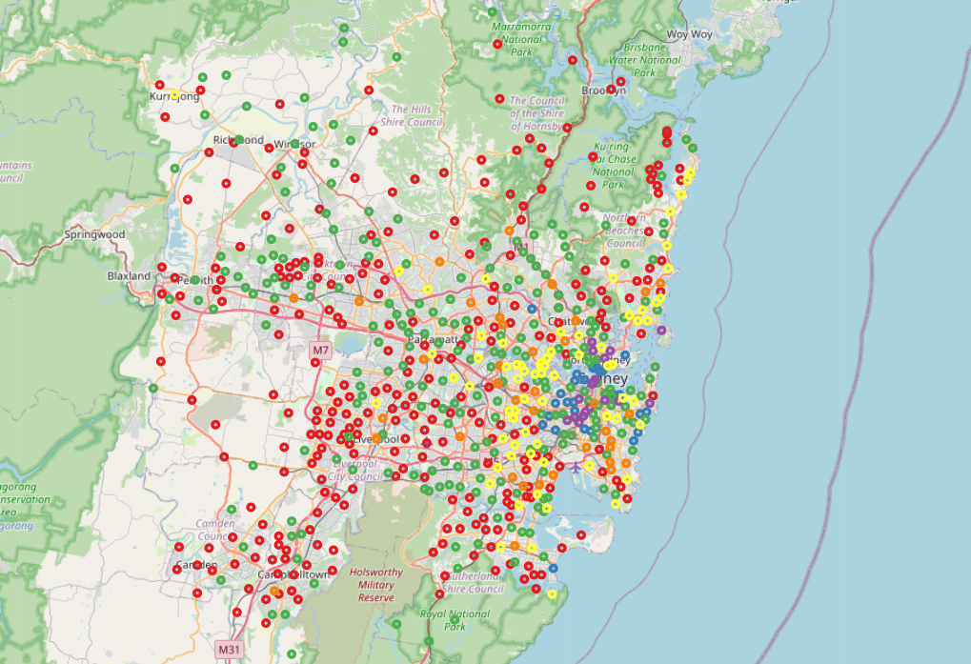
Clustering
Create 6 clusters of suburbs based on venue similarities. This map shows the location of the clusters. Note that cluster 1 (Blue) and 3 (Purple) are located around the CBD area.

Slide 9
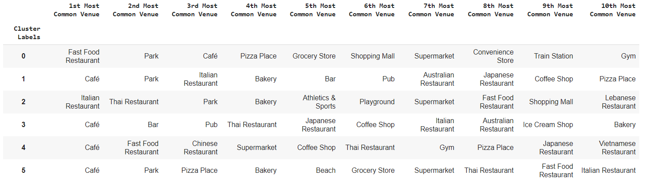
Cluster Top Venues

Slide 10
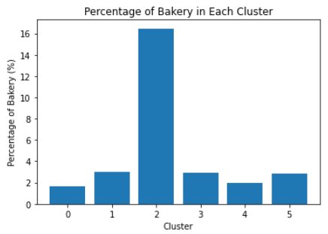
Bakeries In Each Cluster

Slide 11
Results
Cafe is the most popular venue in for clusters
Based on the map computed, it seems location affects the venues in suburbs

Slide 12
Results
- Cluster 0: has the lowest competition in bakery business compared to the other clusters. Retail businesses and the train station are among the most common in the area, while bakery is not in the top 10.
- Cluster 1: Bakery is the 4th most common venue in this area although the percentage of bakery is relatively low. Suburbs of this cluster are distributed around CBD.

Slide 13
Results
- Cluster 2: Has the highest competition in bakery business. Bakery is the 4th most common venue in this cluster. Due to the competition, it might be unwise to open a new bakery in this area.
- Cluster 3: Similarly to Cluster 1, bakery is among the most common venues although the competition is relatively low. Most suburbs in this cluster are distributed around CBD

Slide 14
Results
-Cluster 4: The majority of the most common venues in this clusters are food service and the competition for bakery is relatively low
-Cluster 5: Bakery is the 4th most common venue in this area although the percentage of bakery is relatively low. Suburbs of this cluster are distributed around beaches and parks.

Slide 15
Conclusion
Based on the results, I would recommend to open a bakery in suburbs in cluster 0

